Slide 1
UMLS ON CREDIT FRAD DETECTIONS

Slide 2
Class diagram:

Slide 3
Activity diagram:
Activity diagrams are graphical representations of Workflows of stepwise activities and actions with support for choice, iteration and concurrency. In the Unified Modeling Language, activity diagrams can be used to describe the business and operational step-by-step workflows of components in a system. An activity diagram shows the overall flow of control.

Slide 5
Sequence diagram:
A sequence diagram in Unified Modeling Language (UML) is a kind of interaction diagram that shows how processes operate with one another and in what order. It is a construct of a Message Sequence Chart. A sequence diagram shows, as parallel vertical lines ("lifelines"), different processes or objects that live simultaneously, and, as horizontal arrows, the messages exchanged between them, in the order in which they occur. This allows the specification of simple runtime scenarios in a graphical manner.

Slide 6
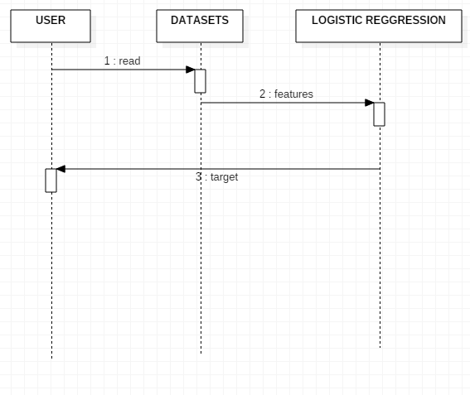

Slide 7
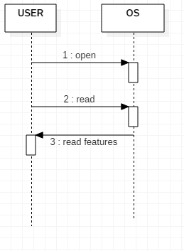

Slide 8
Component diagram

Slide 9
Deployement diagram:

Slide 10
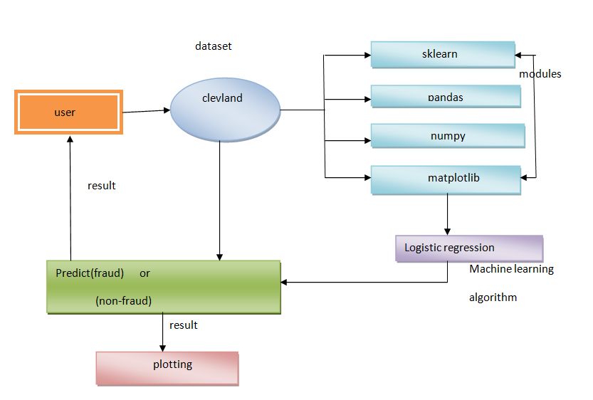
Architecture

